Slide 1
How to use supercomputers
- Virtual machine and HPC

Slide 2
Virtual machines in Cloud
Amazon cloud
Opensciencedatacloud.org

Slide 3
Putty package
PuTTY: | putty.exe | (the SSH and Telnet client itself)
PSCP: | pscp.exe | (an SCP client, i.e. command-line secure file copy)
PSFTP: | psftp.exe | (an SFTP client, i.e. general file transfer sessions much like FTP)
Pageant: | pageant.exe | (an SSH authentication agent for PuTTY, PSCP, PSFTP, and Plink)
PuTTYgen: | puttygen.exe | (an RSA and DSA key generation utility).

Slide 4
Overall workflow
Login node
Login to VM - Computing node

Slide 5
“Key” to login
Key pairs
Public key and private key
Passphrase

Slide 6
Step 1
Pageant
To add private key
Putty
To login to “log in node”

Slide 7
Key
Generated by PUTTYGEN
Load by Pageant:
Ppk file of private key
Connection-> SSH -> Auth: “allow agent forwarding”
Only need username to login
Passphase is the critical password to remember

Slide 9
VM management
Instance
Load existing instance
Once instance launched, a IP is provided to be accesbile by a SSH from the login node
SSH –A Ubuntu@IP of the VM
Configure new VM
Need to install your own software, by root user
“Sudo passwd root” to create password for root

Slide 10
Terminate instance

Slide 11
How to manage disk space
Once log in to the VM. It will display:
System information as of Mon Nov 16 10:32:38 CST 2015
System load: 0.33 Processes: 81
Usage of /: 99.8% of 19.69GB Users logged in: 2
Memory usage: 37% IP address for eth0: 172.16.1.117
Swap usage: 0%
=> / is using 99.8% of 19.69GB

Slide 12
Install software in VM (Ubuntu)
Any Ubuntu software
Apt-get install <software name>
eg. > atp-get install make
Perl packages/modules
> cpan
> install <module name>
eg. > install Math::CDF
Root user will make software installation much easier.

Slide 13
Data moving
Sftp to login node, home directory
Like /glusterfs/users/cliu
It will be visible by VM for the same directory name
Sftp to copy data
Lcd to change local (client )directory
Cd to change servser side directory
mput and mget

Slide 14
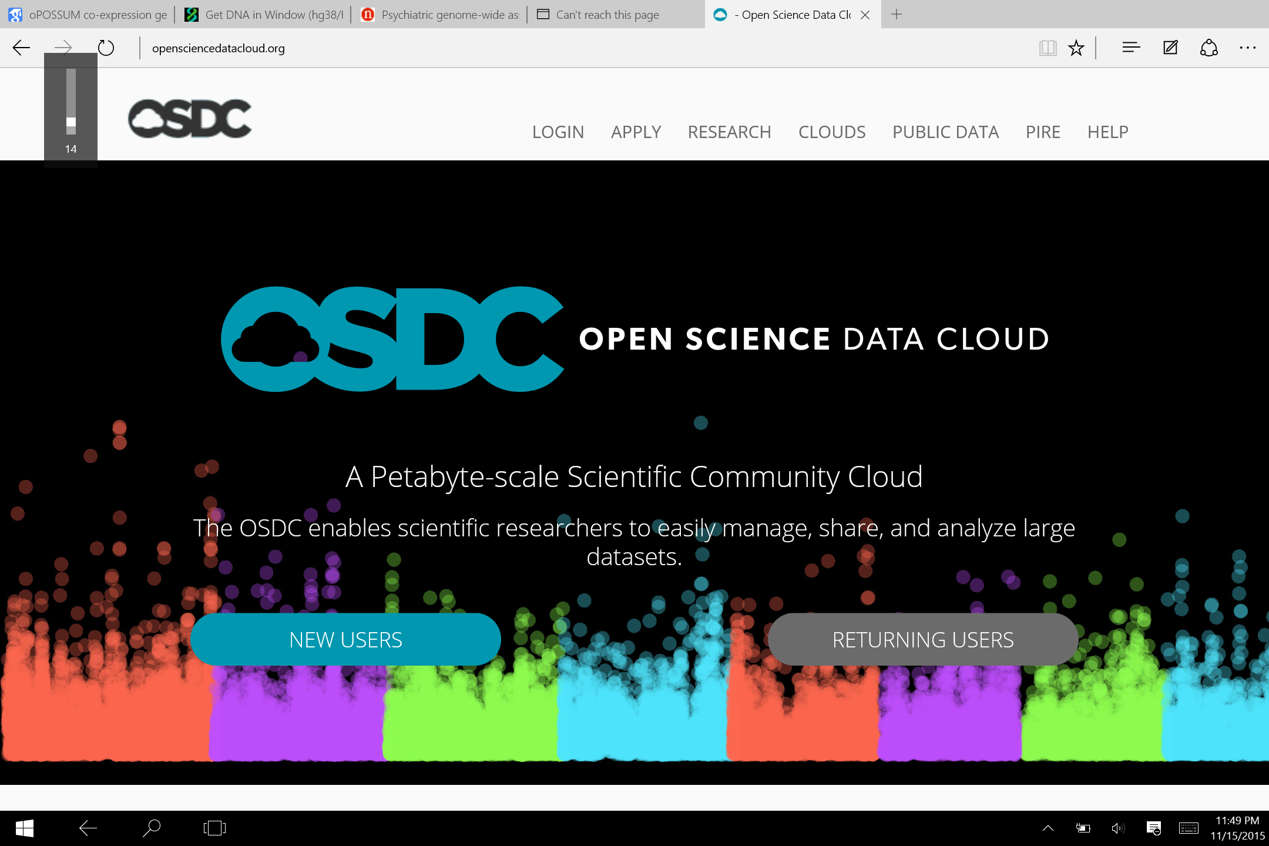

Slide 15
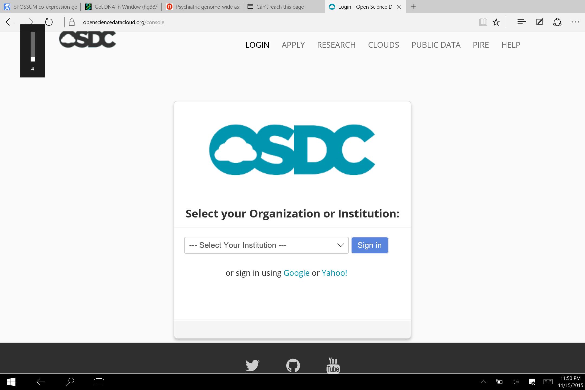

Slide 16
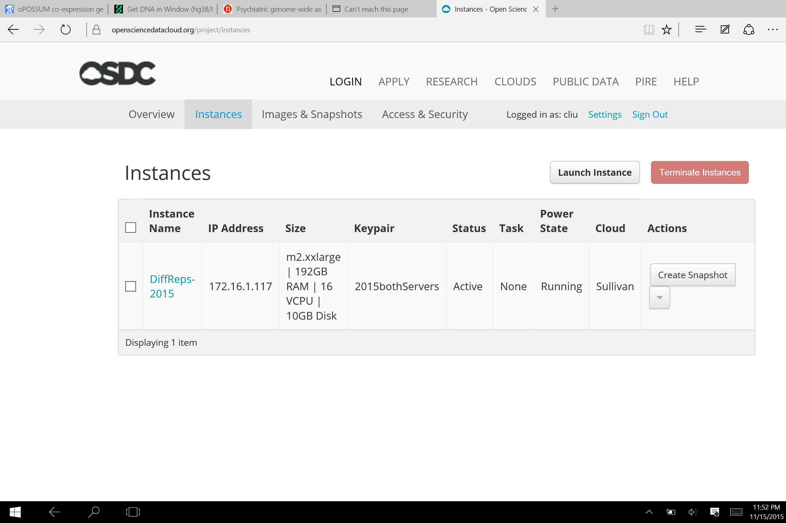

Slide 17
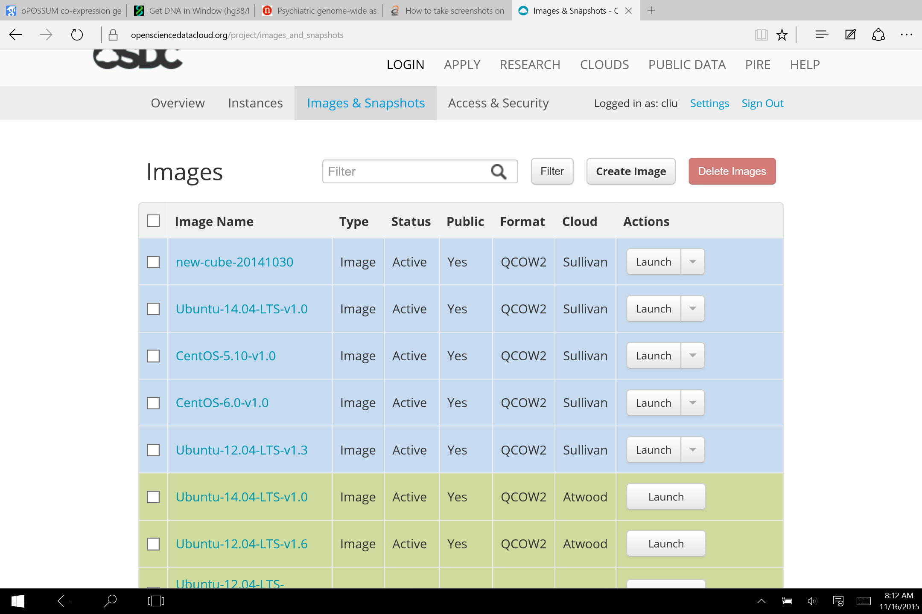

Slide 18
After configuring your VM, always create a snapshot, so that you can launch new VM with that image
Each Instance will occupy resource, and could be charged for the costs – like in Amazon Cloud

Slide 19
Demo video
https://www.opensciencedatacloud.org/support/intro.html#video-osdc-demo
Overall introduction till 11:00 min
11:00 min starts technical details

Slide 20
Beagle2 HPC
After login in, need to use qsub to submit jobs, so computing will be executed in computing nodes, not in login node

Slide 21
Procedures in Beagle
Pageant load private key
Login to login node
Prepare .pbs, .sh and other data files
qsub

Slide 22
qsub
> qsub filename.pbs
Pbs is bulit upon an existing template, which specify working paths, working environment, also call other .sh scripts to execute
Afte qsub, it will generate a job id like “3357695.sdb,” which can be “qstat” to monitor
If failed, files containing the job id will appear, with oxxxxx and exxxxxx (xxxxxx is the job ID)
qdel jobid to delete a job

Slide 23
Using existing modules, or pointing to installed modules (paths)
In Beagle
Swap environment
module swap PrgEnv-cray PrgEnv-gnu
Load installed core module
module load PCAP-core
Or:
> perl –I <path of installed module) perlscript.pl

Slide 24
Data moving in Beagle
Sftp copy to beagle directory
Should store in your own data directory
/lustre/beagle2/username
Qsub can access the directory directly

Slide 25
OSDC vs. HPC
 | OSDC | HPC (beagle)
OS | Linux | Linux
Resource available for computing | Restrict to the VM configured, fixed | Defined in .pbs file, flexible by changing .pbs file
Pre-requisition | Need to launch instance (VM) first | Prepare .pbs and .sh file
procedures | Login to login node, then, ssh to the VM, and execute commands as standalone computer | Login login node, then, qsub .pbs, which execute .sh files
keys | Pageant load, and Putty to ssh in. | SAME as left
Data file access | Psftp to /gclusterfs/users/username; the same dir visuable by VM | Putty access the same directory as any normal computer directory
Job management | Have complete control of the VM, not job queue | Qsub put your job into a queue

